Slide 1





Library DBMS CLI Presenters:
Hadeel Alnumiri
Milad Torang
Hojjat Ollah Saeedi
Nasir Ahmad Dastgirzada

Slide 2


Agenda
Introduction:
Features Overview:
Demonstration:
Benefits:
Conclusion:
ERD Diagram- Impelemantation

Slide 3

Introduction
The Library CLI Application simplifies library management tasks through text-based commands.
It enables librarians to add, search, update, and delete books efficiently.
The CLI interface streamlines administrative functions like generating reports and managing user permissions.
Its purpose is to offer quick, flexible, and scalable library resource management without a graphical interface.

Slide 4

Features Overview:
The CLI Application facilitates efficient library management through features like signing up, signing in, searching for books, adding books, borrowing books, marking books as read, adding books to favourites, and viewing user-specific statistics and managing user authentication, all accessible via a command-line interface for streamlined operations.

Slide 5
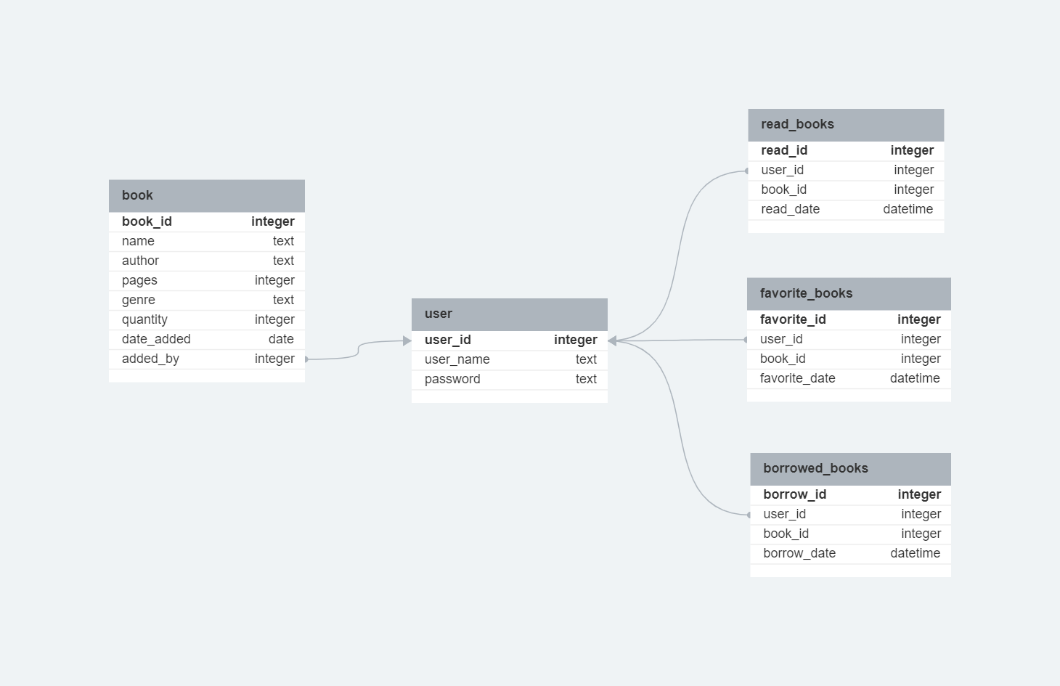
The data in the CLI Application is structured and stored in a relational database management system (RDBMS) SQLite. It typically consists of tables representing entities such as books, users, transactions and library settings. Each table contains fields representing attributes of the corresponding entity, such as book name, author, user ID, and transaction date. Relationships between entities are established through foreign key constraints. This structured approach enables efficient querying, updating, and management of library data, ensuring integrity and consistency throughout the application.
ERD diagram - implementation

Slide 6
Demonstration:
Here's a step-by-step walkthrough of user interactions in the CLI Application:
Start: Launching the Library CLI.
sign_up: Sign up a new user.
delete_user: Delete a user from the database.
sign_in: Sign in a user.
search_by_name: Search for books by name.
search_by_author: Search for books by author.
most_read_books: Display the 10 most-read books.
recently_added: Display the 5 most recent books added.
most_read_genres: Display the 5 most-read genres.
most_read_authors: Display the 3 most-read authors.
add_book: Add a book to the database.
delete_book: Delete a book from the database.
borrow_book: Borrow a book from the library.
return_book: Return a borrowed book to the library.
mark_read: Mark a book as read.
fav_book: Add a book to favorites.
my_books: View user's books.
statistics: View user's reading statistics.

Slide 7
Benefits:
The CLI Application improves library management by automating tasks, enhancing accuracy, enabling accessibility from any terminal, scaling efficiently, centralizing data, and offering cost-effectiveness compared to traditional methods.

Slide 8
Conclusion:
The CLI Application streamlines library management, offering efficiency, accuracy, and accessibility. It centralizes data, scales effectively, and is cost-effective.

Slide 9


THANK YOU
Hadeel Alnumiri
Milad Torang
Hojjat Ollah Saeedi
Nasir Ahmad Dastgirzada

